Slide 1
Sign Language Recognition Using Image Based Hand Gesture Recognition Techniques
Project Members:
Meehir Mhatre 42
Palak Sharma 64
Swastik Poojari 61

Slide 2
Agenda
01
04
Introduction
Architecture
Problem Statement
02
05
Dataset Example
03
06
Algorithm
Segmentation

Slide 3
Introduction
EXPRESS-U
Sign languages are a visual representation of thoughts through hand gestures, facial expressions, and body movements. Sign Languages also have several variants, such as American Sign Language (ASL), Argentinean Sign Language (LSA), British Sign Language (BSL) and ISL.
The hearing and speech impaired people prefer the sign language, which is mostly used in their region. Moreover, in India, there is no universal sign language.
Though there exist many sign languages, the normal people do not know about sign languages. Hence communicating with deaf and dumb people becomes more complex.

Slide 4
PROBLEM STATEMENT
Communication is one of the basic requirements for survival in society. Reports indicate that 11100 or 1% of children are born with hearing impairments. It means that about 50 children with Hearing Impaired are born in a district of 20 lakh population, and about 60 children are born deaf everyday in India. Deaf people communicate among themselves using sign language but normal people find it difficult to understand their language. In addition to this, the lack of datasets along with variance in sign language with locality has resulted in restrained efforts in ISL gesture detection. ISL is also subject to variance in the locality and the existence of multiple signs for the same character.

Slide 5
Literature Survey
Sr. No | Year,Journal | Title | Methodology | Advantages | Result
1) | 2019, IEEE | Real-Time Recognition of Indian Sign Language | Fuzzy c-means clustering | Capable of recognising 40 words of ISL in real-time | 75 %
2) | 2020, IEEE | Sign Language to Speech Translation | CNN | Classify both one-handed and two-handed signs. | 75%
3) | 2019, IEEE | Real-Time Translation of Indian Sign Language using LSTM | Recurrent neural networks (RNNs) | The designed glove uses low-cost hardware, making it affordable for the users. | 98%
4) | 2021, IEEE | Artificial Neural Network based Indian Sign Language Recognition using hand crafted features | Artificial Neural Network | Images here are captured using digital camera, but can be in future replaced by mobile camera. | 98%
5) | 2020, IEEE | Gesture Recognition Using Deep Learning | Deep Learning | The application recognize in real time and in varying backgrounds | 99%
6) | 2019, IEEE | Real Time Conversion of Sign Language using Deep Learning for Programming Basics | Deep Learning | System detects one-handed and two-handed gestures | 61.58%
7) | 2019, IEEE | Indian Sign Language converter using Convolutional Neural Networks | CNN | Classifying 26 letters of the Indian Sign Language into their equivalent alphabet letters by capturing a real time image | 87.69%
8) | 2020,IEEE | SIGN LANGUAGE RECOGNITION USING TEMPLATE MATCHING TECHNIQUE | Deep Learning | Detects ASL and ISL. | 75%

Slide 6
AIM
ACCURATE
ACCESSIBLE
FAST AND RELIABLE
Our project aims at taking the basic step in bridging the
communication gap between normal people and deaf people
using Indian sign language by developing an app which helps
the normal people to understand the sign language.

Slide 7
Algorithm
VGG16 is a convolution neural net (CNN ) architecture. Most unique thing about VGG16 is that instead of having a large number of hyper-parameter they focused on having convolution layers of 3x3 filter with a stride 1 and always used same padding and maxpool layer of 2x2 filter of stride 2. In the end it has 2 FC(fully connected layers) followed by a softmax for output. The 16 in VGG16 refers to it has 16 layers that have weights. This network is a pretty large network and it has about 138 million (approx) parameters.The model achieves 92.7% top-5 test accuracy in ImageNet, which is a dataset of over 14 million images belonging to 1000 classes.

Slide 8
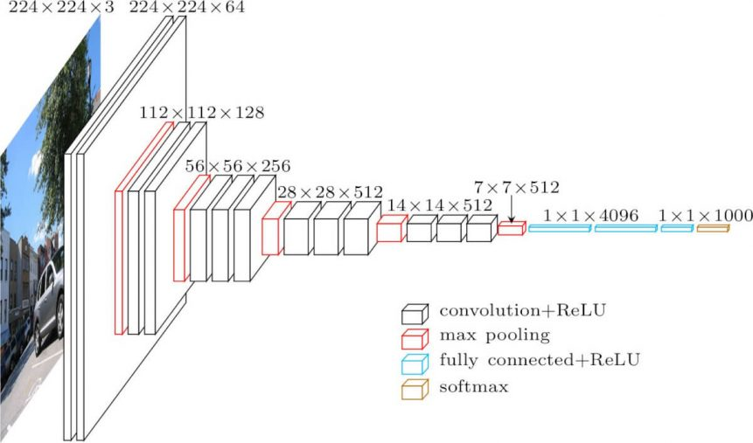
Architecture

Slide 9
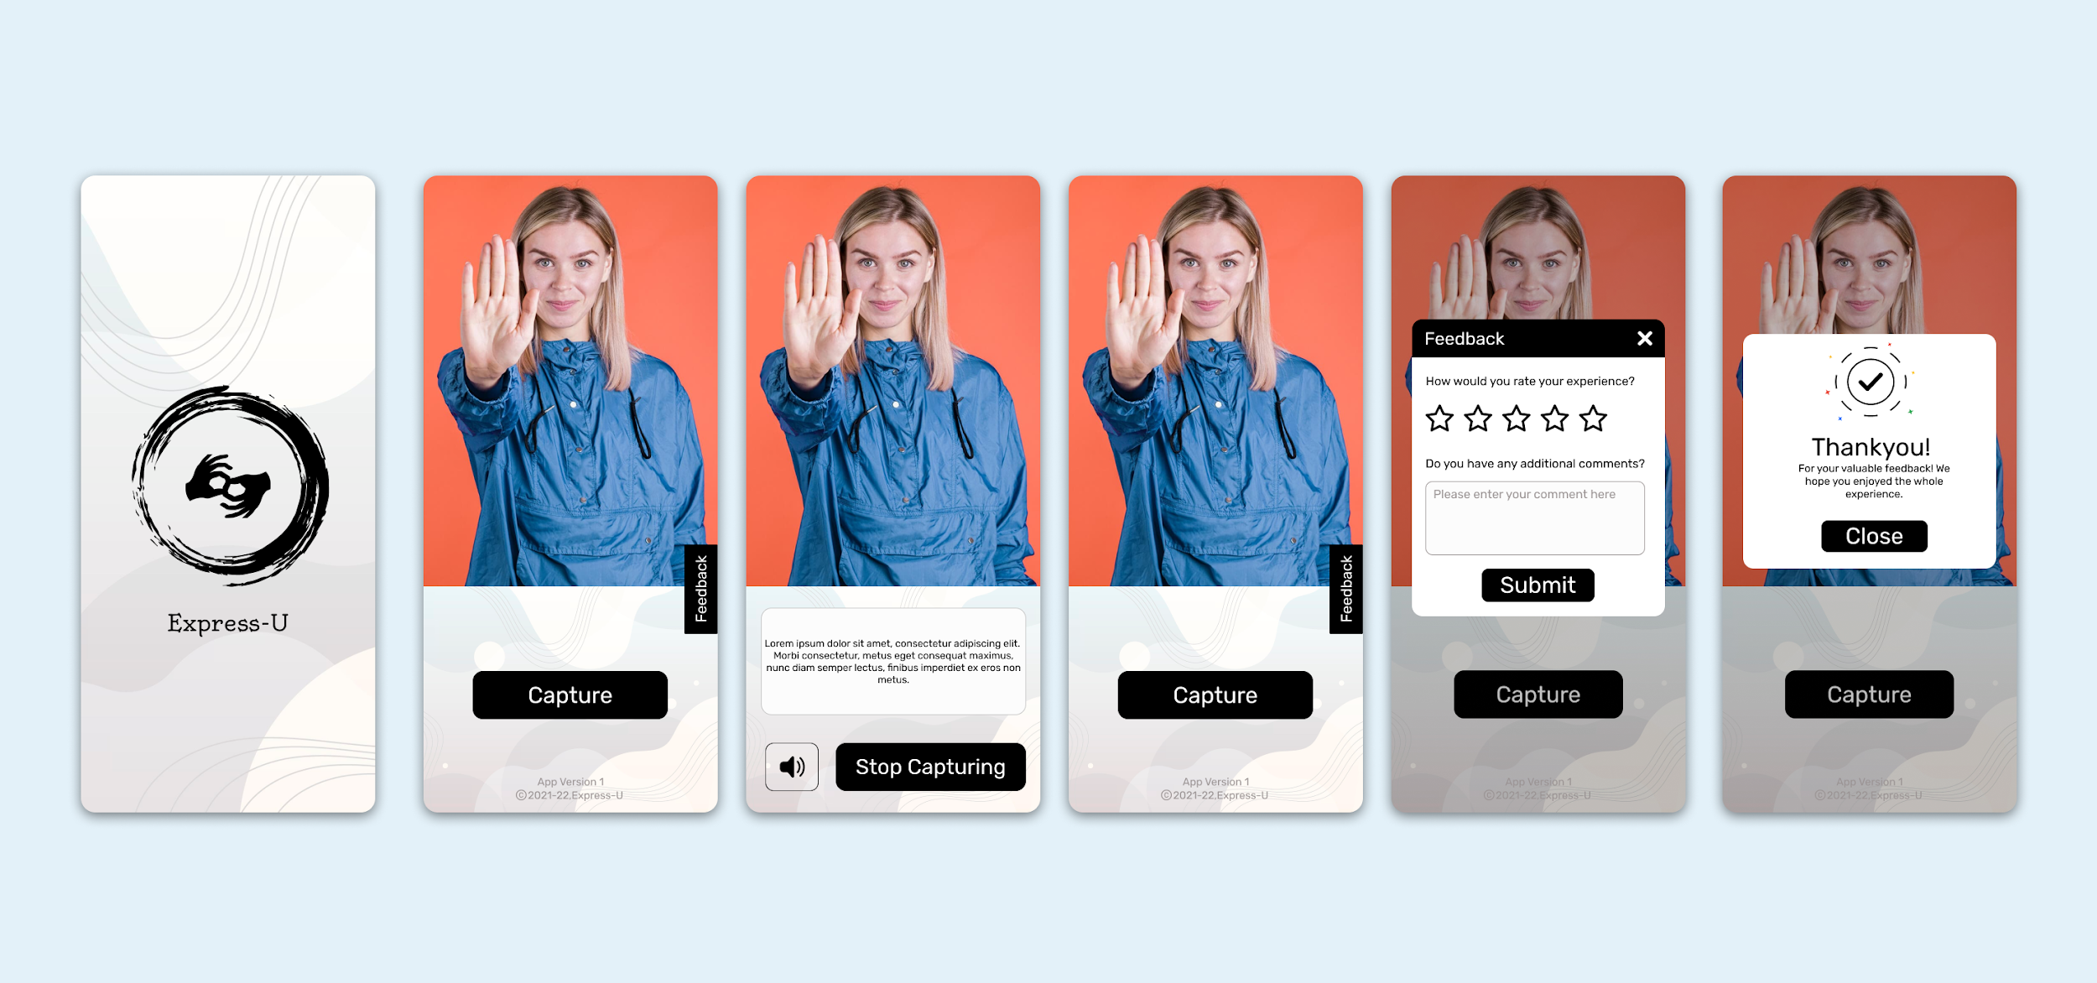
Express-U User Interface

Slide 10
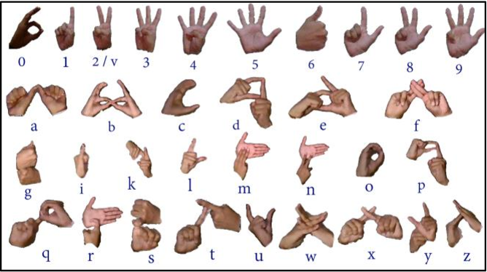
Dataset Example

Slide 11
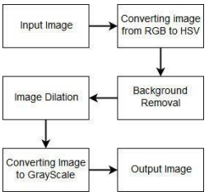
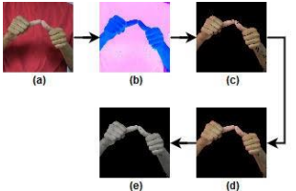
Hand Segmentation & Filtering of Dataset

Slide 12


Slide 13
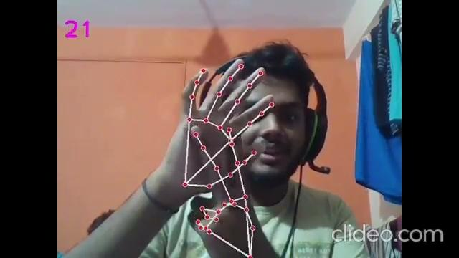

Slide 14
REFERENCES
1. Indian Sign Language Recognition Using Convolutional Neural Networks https://link.springer.com/chapter/10.1007/978-981-15-9293-5_35
2. Corballis MC (2003) From mouth to hand: gesture, speech and the evolution of right-handedness. Behav Brain Sci 26(2):199–208
3. Oyedotun OK, Khashman A (2017) Deep learning in vision-based static hand gesture recognition. Neural Comput Appl 28(12):3941–3951
4. Ronchetti, F., Quiroga, F., Estrebou, C.A., Lanzarini, L.C.: Handshape recognition for Argentinian sign language using probsom. J. Comput. Sci. Technol. 16 (2016)
5. Singha, J., Das, K.: Automatic Indian Sign Language recognition for continuous video sequence. ADBU J. Eng. Technol. 2(1) (2015)
6. Tripathi, K., Nandi, N.B.G.C.: Continuous Indian Sign Language gesture recognition and sentence formation. Procedia Comput. Sci. 54, 523–531 (2015)
7. Nandy, A., Prasad, J.S., Mondal, S., Chakraborty, P., Nandi, G.C.: Recognition of isolated Indian Sign Language gesture in real time. Inf. Process. Manag., 102–107 (2010)
8. Becky Sue Parton “Sign language recognition and translation: A multidisciplined approach from the field of artificial intelligence”. Journal of deaf studies and deaf education, 11 (1): 94–101, 2005.
9. Mukul Singh Kushwah, Manish Sharma, Kunal Jain, and Anish Chopra “Sign language interpretation using pseudo glove”. In Proceeding of International Conference on Intelligent Communication, Control and Devices, pages 9–18. Springer, 2017.

Slide 15
Thankyou

